Slide 1
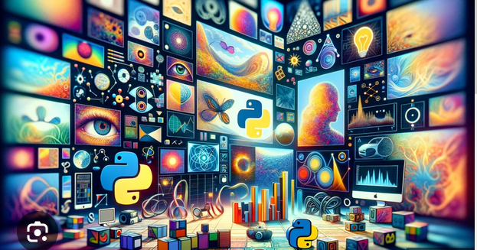
Introduction to Image Processing

Slide 2
What is image processing?
A method of performing operations on an image to enhance it or extract useful information.
Involves manipulating and analyzing digital images to improve their quality or to extract specific features for further analysis.

Slide 3

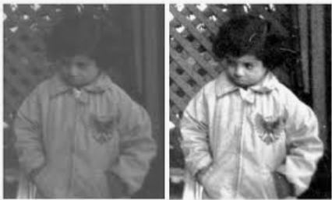
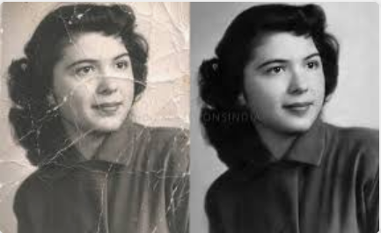
Significance of image processing - 1
Enhancement of visual information
Improvement in image quality - Techniques like noise reduction, contrast enhancement, and sharpening make images clearer and more useful for human viewing and interpretation.
Restoration - Damaged or degraded images can be restored to their original quality, making old or corrupted images usable again.
Image sharpening
Image contrast enhancement
Image restoration

Slide 4
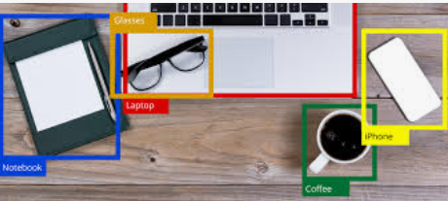
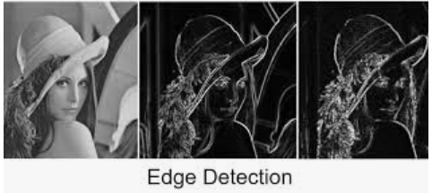
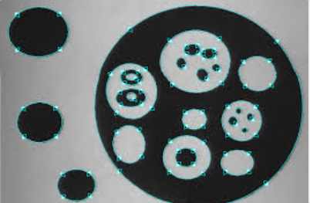
Significance of image processing - 2
Automated Analysis and Interpretation
Object Recognition - Identifying objects within an image is crucial for applications such as automated inspection, robotics, and autonomous vehicles.
Feature Extraction - Extracting features such as edges, textures, and shapes enables further analysis and decision-making in applications such as medical imaging, industrial quality control etc.
Object recognition
Shape extraction

Slide 5
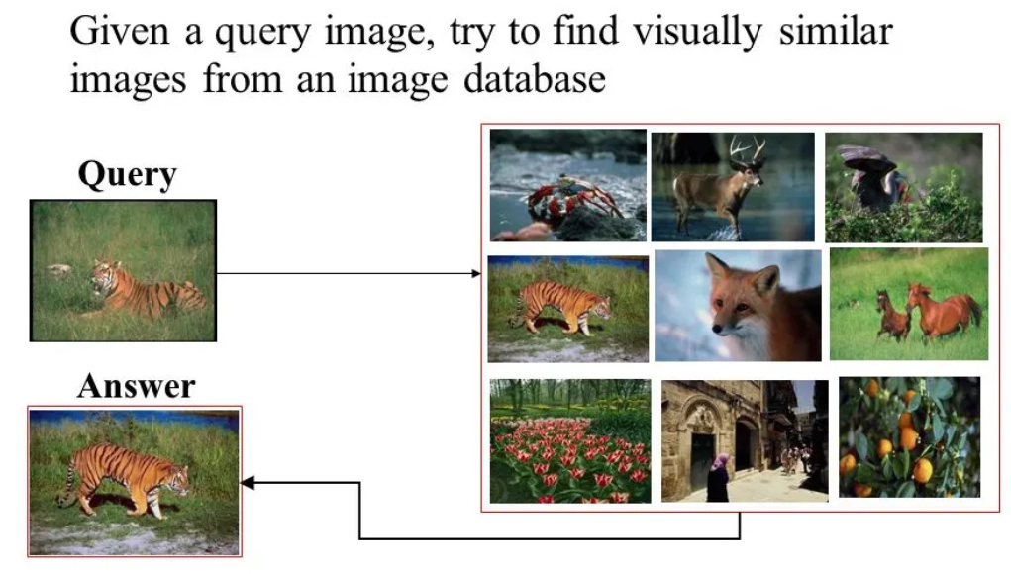

Significance of image processing - 3
Accessibility and Preservation of Information
Document Processing - Converts physical documents into digital form, making them easier to store, search, and share, and preserving important information.
Content-Based Image Retrieval - Allows for efficient searching and indexing of large image databases based on content rather than metadata alone.
Document processing
Content-based image retrieval

Slide 6
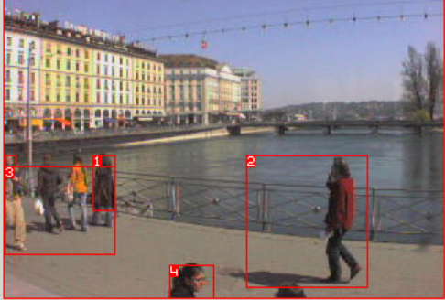
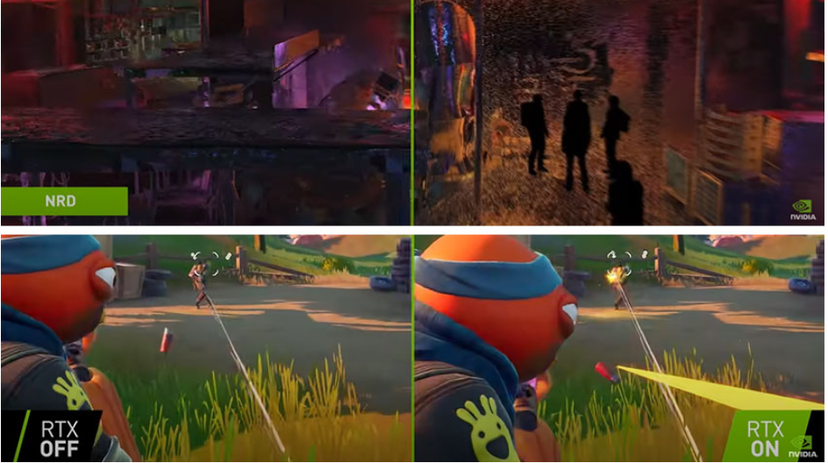
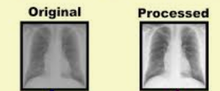
Significance of image processing - 4
Enabling New Technologies and Applications
Medical Imaging - Enhances the ability to diagnose and treat medical conditions by improving the quality of images from X-rays, MRI, and CT scans.
Surveillance and Security - Improves the effectiveness of monitoring systems through techniques like motion detection, face recognition, and anomaly detection.
Entertainment and Media - Enhances visual content in movies, video games, and virtual reality, creating more immersive and visually appealing experiences.
Medical imaging
Motion detection
Video games

Slide 7
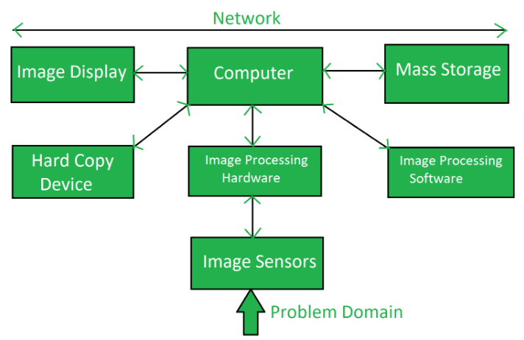
Components of image processing system

Slide 8
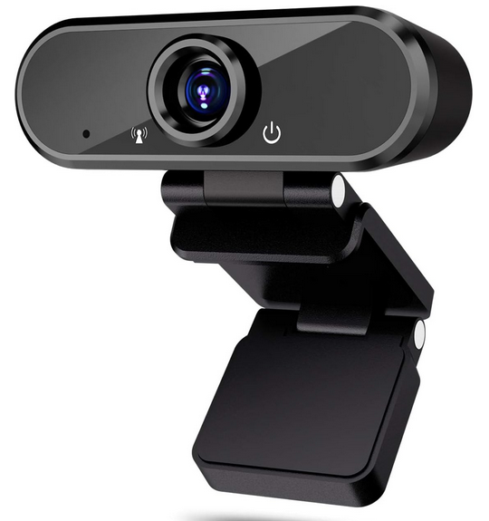
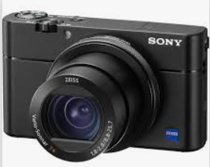
Image sensors
Devices such as digital cameras, webcams, scanners, and specialized imaging sensors capture images or video sequences.
Image sensors senses the intensity, amplitude, co-ordinates and other features of the images and passes the result to the image processing hardware.

Slide 9
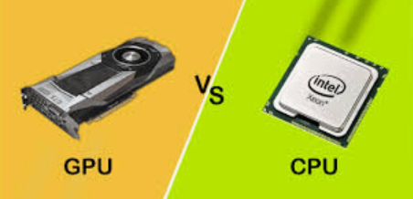
Image Processing Hardware
Used to process the instructions obtained from the image sensors. It passes the result to general purpose computer.
CPUs (Central Processing Units) and GPUs (Graphics Processing Units) handle the computationally intensive tasks of image processing.
Dedicated image processors are specialized hardware designed for high-speed image processing tasks.

Slide 10
Computer
Computer used in the image processing system is the general purpose computer that is used by us in our daily life.
The computer plays a central role in an image processing system, serving as the hub for performing various operations and tasks.

Slide 11

Image Processing Software
Includes all the mechanisms and algorithms that are used in image processing system.
Algorithms and Libraries : Provide functions and algorithms for processing images. Examples include OpenCV, MATLAB Image Processing Toolbox, and proprietary software.
Development Environments: Platforms and frameworks used to develop image processing applications, such as Python with OpenCV, MATLAB, and other programming environments.

Slide 12
Mass storage
Mass storage stores the pixels of the images during the processing.
RAM (Random Access Memory): Temporary storage for images during processing.
Hard Drives and SSDs (Solid State Drives): Long-term storage for storing captured and processed images.

Slide 13
Other components
Hard Copy Device : Once the image is processed then it is stored in the hard copy device. It can be a pen drive or any external ROM device.
Image Display : Monitors and Screens are used to display images and the results of image processing.
Network : Networking Hardware and Protocols allow for the transmission of images and data between different parts of the system or between systems in a distributed environment.

Slide 14
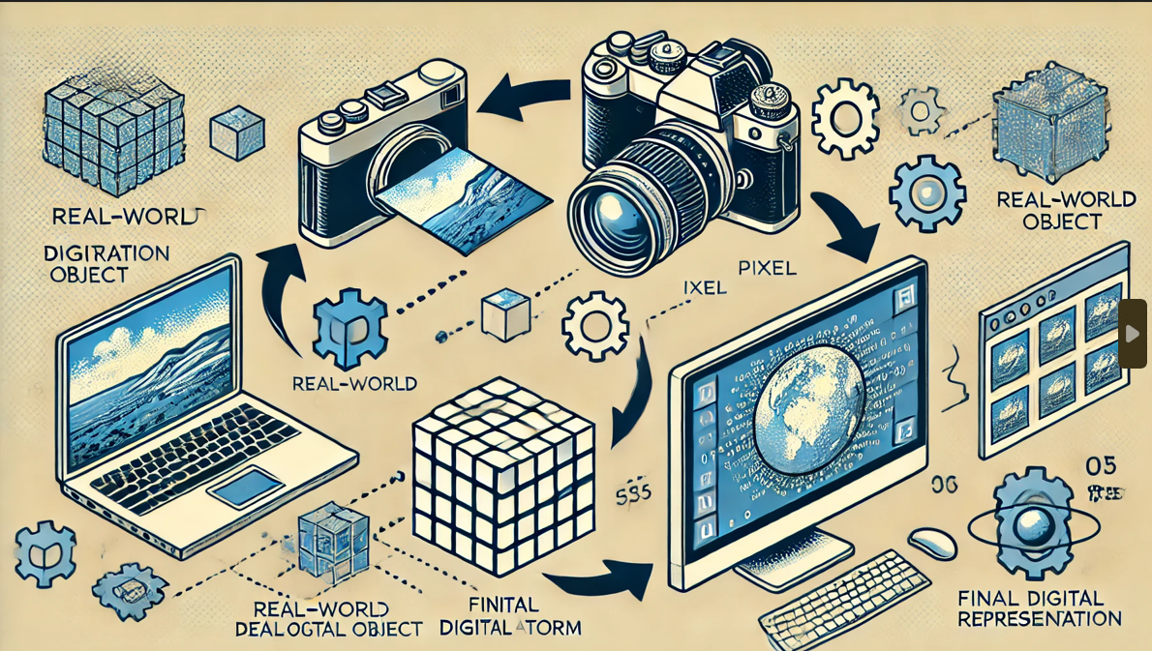
Image Formation and Digitization Concepts

Slide 15
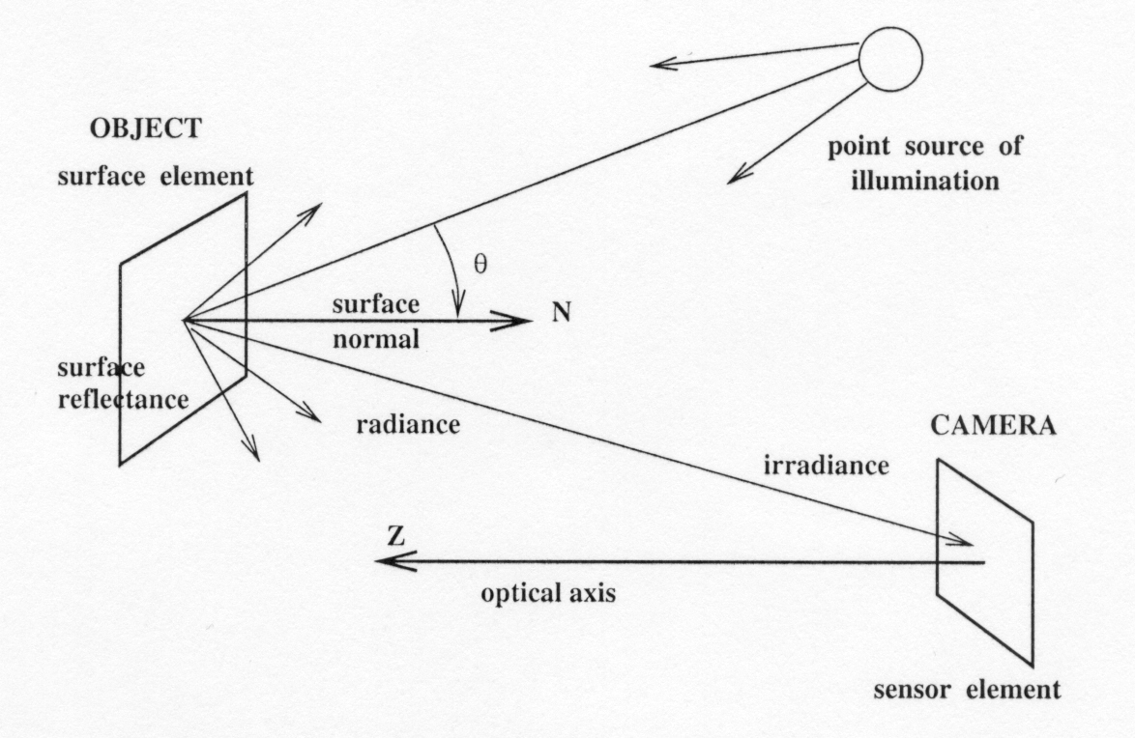
Image formation
The scene is illuminated by a single source.
The scene reflects radiation towards the camera.
The camera senses it via solid state cells (CCD cameras).
A CCD camera, or Charge-Coupled Device camera, is a device that captures images by converting photons (light) into electrons.
It utilizes a CCD sensor, which is a light-sensitive integrated circuit composed of pixels.
Each pixel in the sensor converts light into an electrical charge, and these charges collectively form the image.
CCD cameras are known for their high sensitivity, dynamic range, and uniformity.

Slide 16
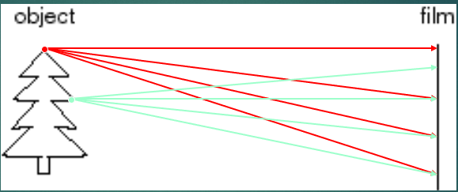
Let’s design a camera
Put a piece of film in front of an object - do we get a reasonable image?
Blurring - need to be more selective!

Slide 17
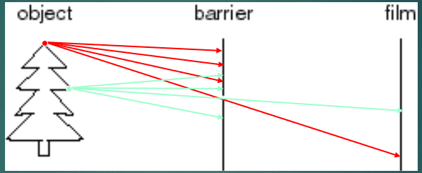
Let’s design a camera (cont.)
Add a barrier with a small opening (i.e. aperture) to block off most of the rays.
Reduces blurring.

Slide 18
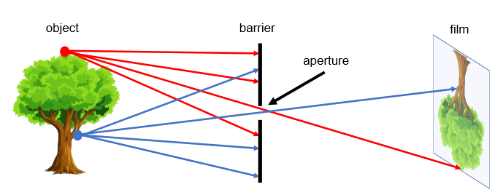
Pinhole camera model
This camera system can be designed by placing a barrier with a small aperture between the 3D object and a photographic film or sensor.
Each point on the 3D object emits multiple rays of light outwards.
Without a barrier in place, every point on the film will be influenced by light rays emitted from every point on the 3D object.
Due to the barrier, only one (or a few) of these rays of light passes through the aperture and hits the film.
Therefore, we can establish a one-to-one mapping between points on the 3D object and the film.
The result is that the film gets exposed by an “image” of the 3D object by means of this mapping.

Slide 19
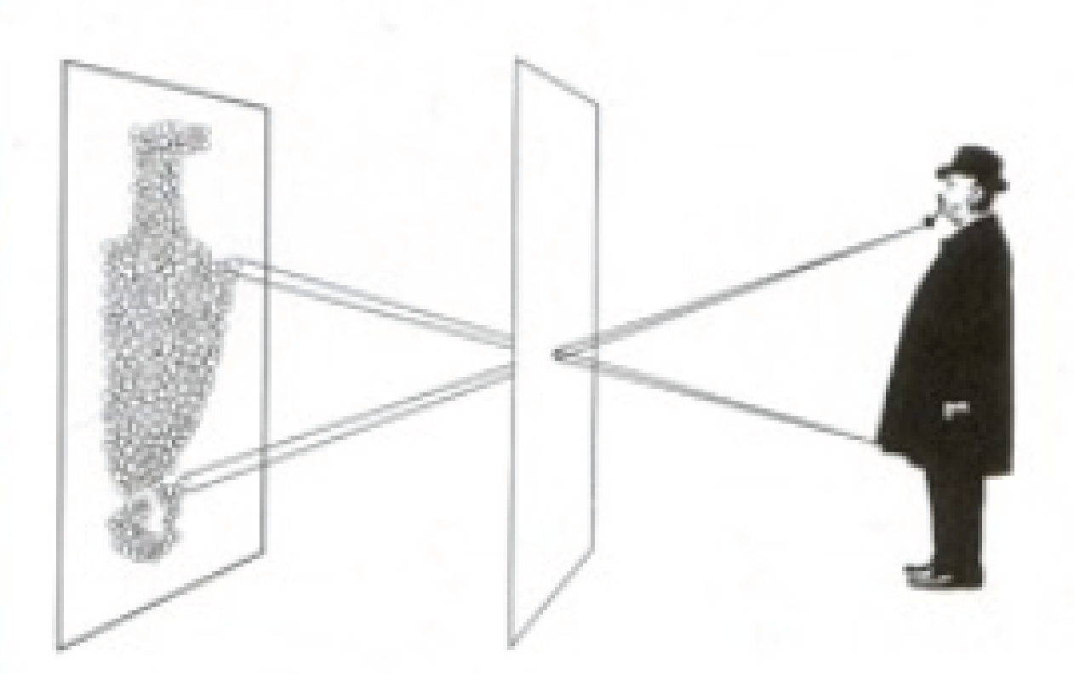
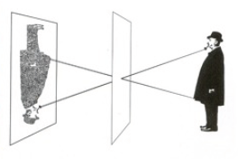
Effect of aperture size
Large aperture: light from the source spreads across the image (i.e., not properly focused), making it blurry!
Small aperture: reduces blurring but (i) it limits the amount of light entering the camera and (ii) causes light diffraction.

Slide 20
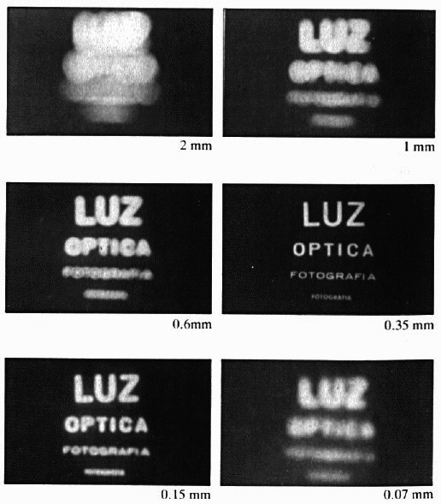
Varying aperture size example

Slide 21
Example: varying aperture size (cont’d)
What happens if we keep decreasing aperture size?
When light passes through a small hole, it does not travel in a straight line and is scattered in many directions (i.e., diffraction)

Slide 22
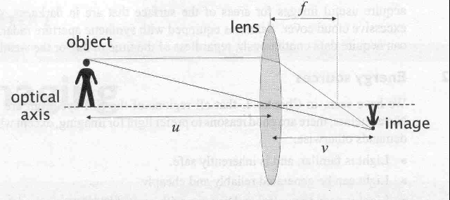
Lens
Lens duplicates pinhole geometry without resorting to undesirably small apertures.
Gathers all the light radiating from an object point towards the lens’s finite aperture.
Brings light into focus at a single distinct image point.

Slide 23
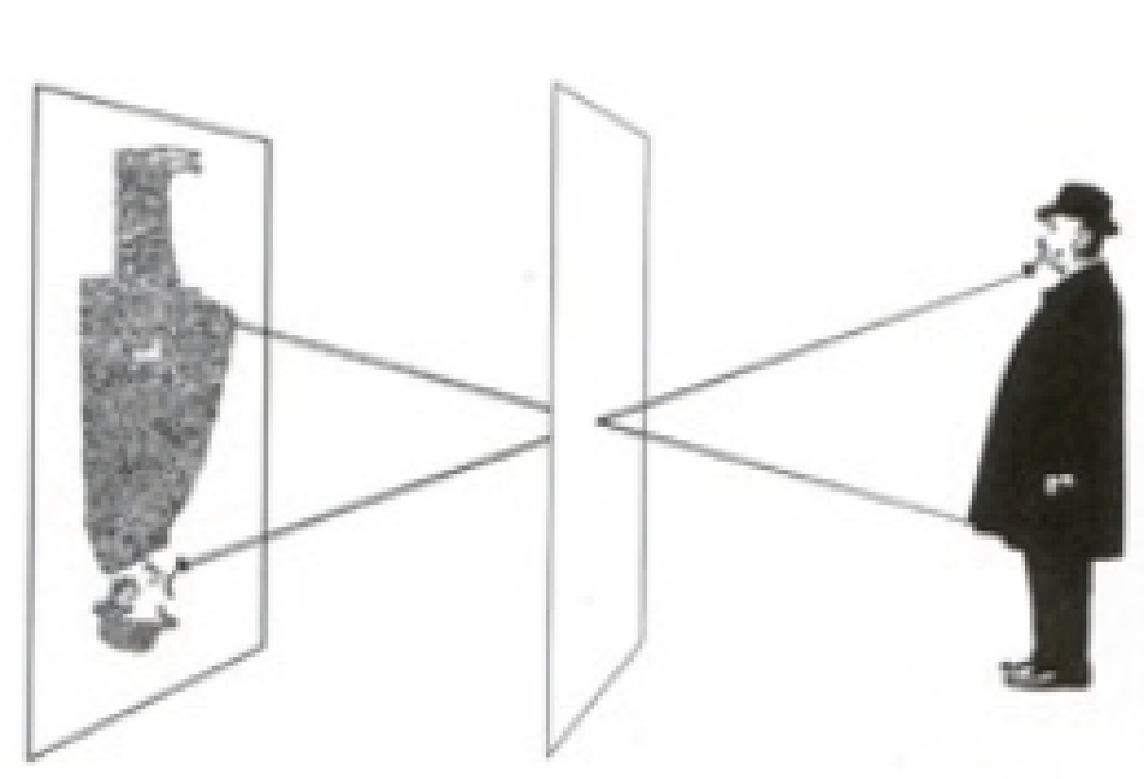
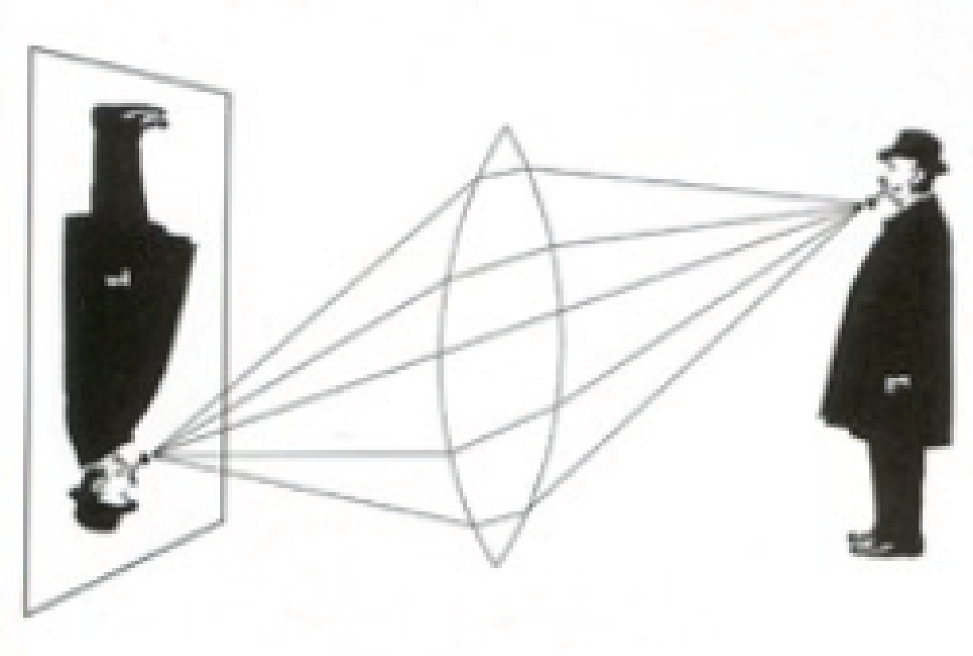
Lens (cont.)
Brightness : A lens allows more light to enter the camera which results in a brighter image.
Aperture size : Lenses can have larger apertures, which means they can capture more light without the need for a long exposure time.
Focus mechanism : Lenses can be moved to adjust the focus, allowing for clear images of objects at various distances from the camera.
Depth of field : Lenses can control the depth of field, enabling photographers to focus on specific parts of a scene while blurring out the background or foreground, adding artistic effects and enhancing image clarity.

Slide 24

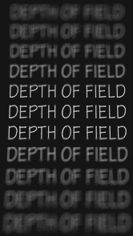
Depth of Field
The range of depths over which the world is approximately sharp (i.e., in focus).
It is the zone of sharpness in front of and behind the subject where the image remains in focus.
Outside of this zone, the image gradually becomes blurry.

Slide 25

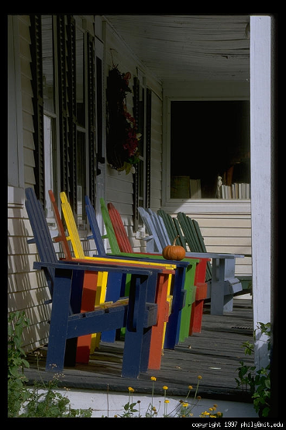
Effect of aperture on Depth of Field (DoF)
A larger aperture results in a shallow depth of field, meaning only a small portion of the image will be in focus, and the background and foreground will be blurred.
A smaller aperture results in a deeper depth of field, meaning a larger portion of the image will be in focus, with less background and foreground blur.
Large aperture = small DOF
Small aperture = large DOF

Slide 26
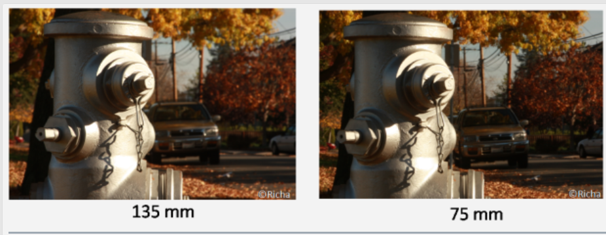
Effect of focal length on Depth of Field
Lenses with longer focal lengths (e.g., telephoto lenses) tend to have a shallower depth of field. Hence the subject will be in focus and background will be blurry.
Lenses with shorter focal lengths (e.g., wide-angle lenses) tend to have a deeper depth of field. Hence both the subject and background will be focused.

Slide 27
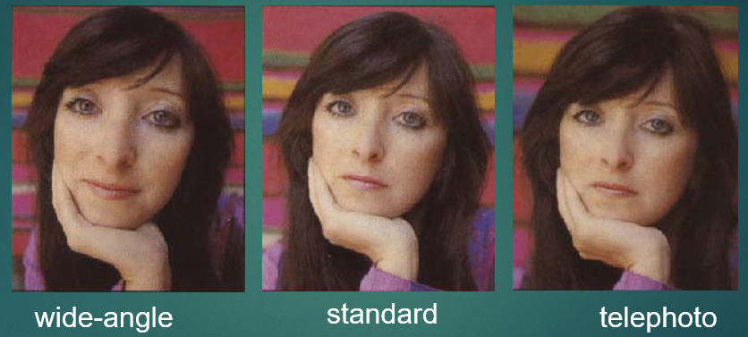
Effect of camera focal length on faces

Slide 28

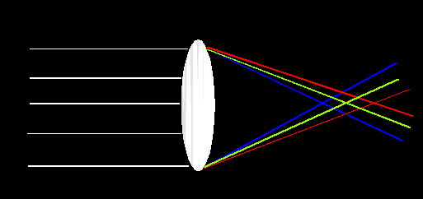
Lens flaws : chromatic aberration
Occurs when different wavelengths (colors) of light are not focused at the same point.
This results in a color fringing or blurring of the image, typically seen as colored edges around high-contrast areas.

Slide 29
Correcting chromatic aberration
Anti-reflective coatings on lens elements help to minimize the dispersion of light and reduce chromatic aberration.
Achromatic Lenses: Combine two types of glass with different dispersion properties to bring two wavelengths (typically red and blue) into the same focus.
Digital Correction : Modern cameras and image processing software can correct chromatic aberration during post-processing by realigning the color channels.

Slide 30
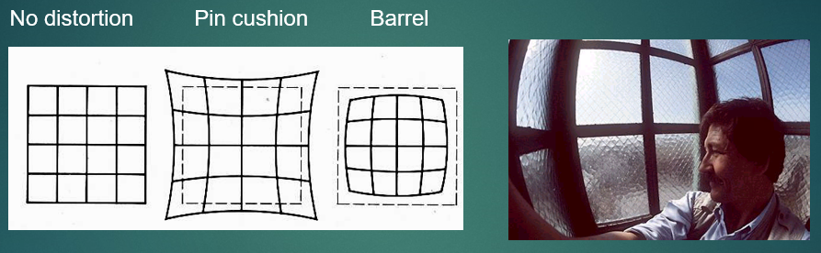
Lens flaws : radial distortion
A type of lens distortion that causes straight lines to appear curved in an image.
Occurs because the magnification of the lens decreases or increases with the distance from the optical axis.
Deviations are most noticeable for rays that pass through the edge of the lens.
Radial distortion is particularly noticeable in wide-angle and fisheye lenses.

Slide 31
Correcting radial distortion
Lens Design Improvements: Modern lens designs incorporate aspherical elements and other advanced technologies to minimize radial distortion.
Camera Firmware: Many modern cameras have built-in firmware that automatically corrects radial distortion based on lens profiles.
Software Tools: Image processing software like Adobe Photoshop, Lightroom, and specialized lens correction software can correct radial distortion by adjusting the curvature of lines in the image.

Slide 32
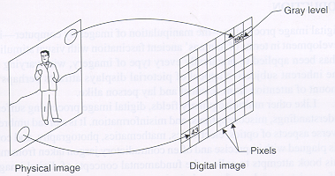
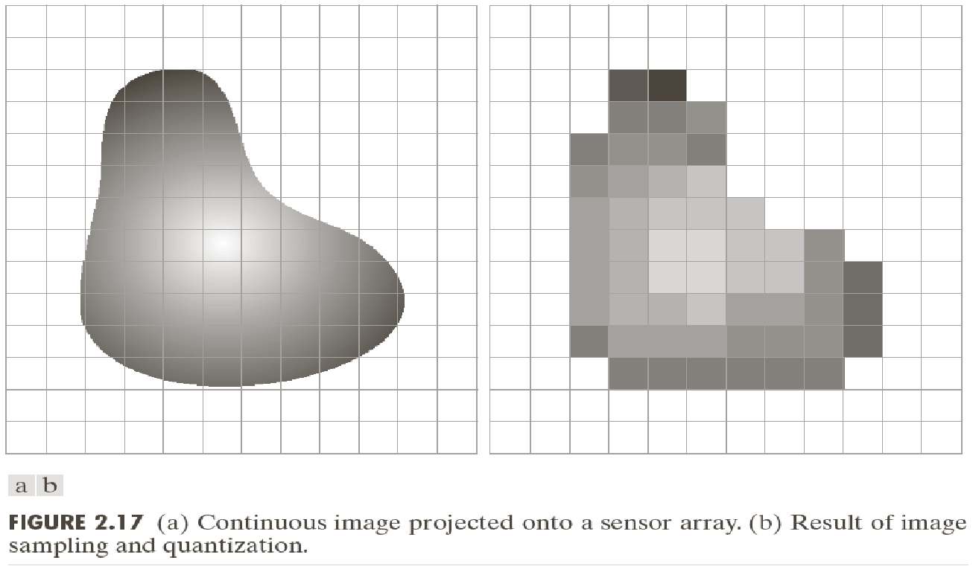
Image digitization
Sampling : Measures the value of an image at a finite number of discrete points.
Quantization : Represents the measured values (e.g., voltage) at the sampled points by discrete integers.
(a) Continuous image projected onto a sensor array (b) Result of image sampling and quantization

Slide 33
Sampling
Sampling involves taking measurements of the image's intensity (brightness or color) at specific, evenly spaced intervals across the image. These measurements are taken at discrete points that correspond to the pixels in a digital image grid.
Sampling reduces a continuous image to a set of values at discrete locations (pixels).
Spatial resolution : The density of these points (pixels per unit area) determines the image's spatial resolution, with higher resolution providing more detail.
Example : If an analog image is sampled at 300 pixels per inch (PPI), it means that the image's intensity is measured at 300 evenly spaced points per inch in both the horizontal and vertical directions.

Slide 34
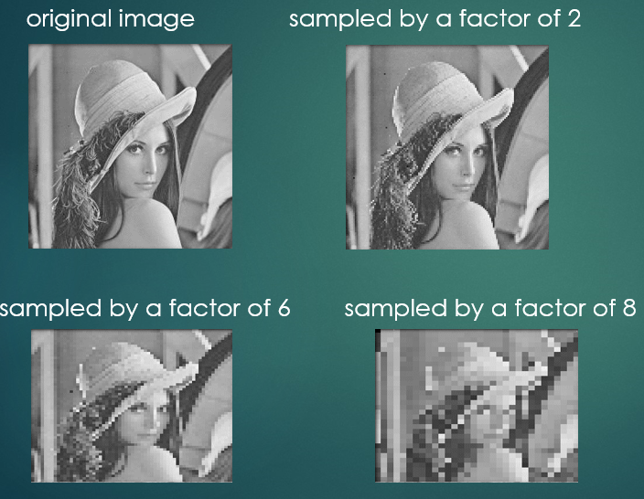
Image Sampling
Images have been resized
for easier comparison.

Slide 35
Quantization
After the image has been sampled, each sampled value (which could initially be a continuous range of values, such as a voltage) is mapped to the nearest value within a finite set of discrete levels.
This process assigns an integer value to each sampled point, thereby converting the continuous range of intensities into a finite number of levels that can be stored and processed digitally.
Discrete Levels: Quantization converts continuous intensity values into a finite set of discrete levels.
Bit Depth: The number of discrete levels is determined by the bit depth. For example, an 8-bit system can represent 256 (2^8) discrete levels.
Example : If the intensity of a pixel is measured and found to be 123.7 (on a continuous scale), in an 8-bit quantization system, this might be represented by the nearest integer value of 124.

Slide 36
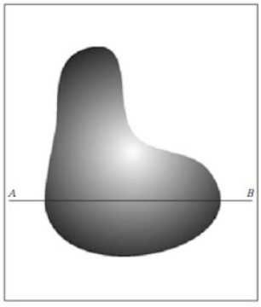
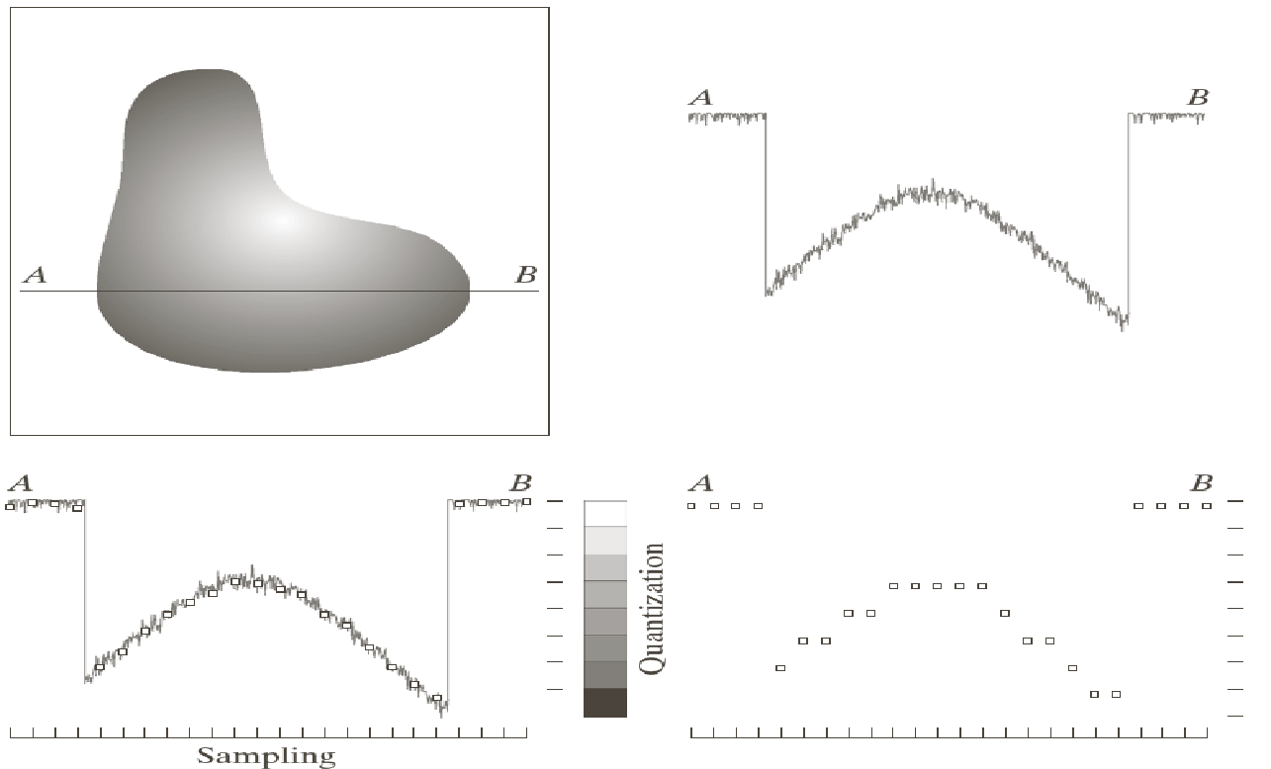
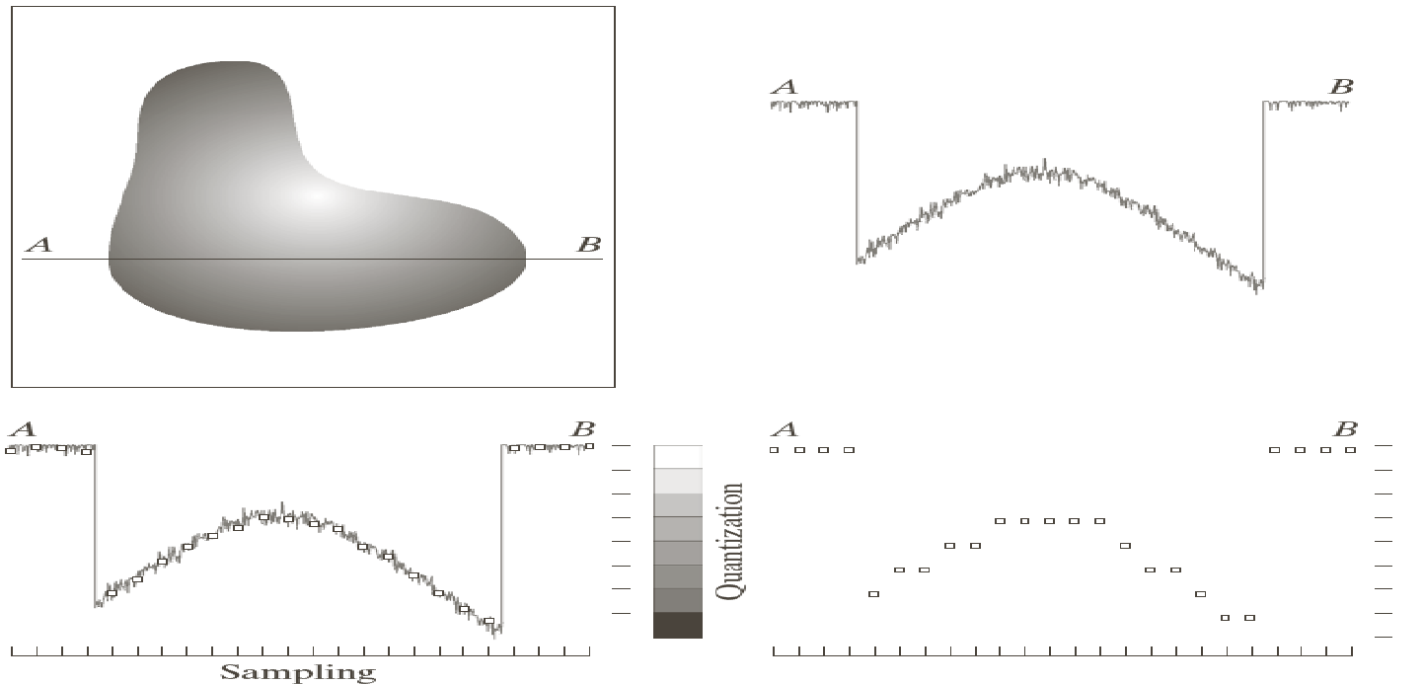
Sampling vs Quantization
Sampling: Converts continuous spatial coordinates into discrete pixels.
Quantization: Converts continuous intensity values at those pixels into discrete integer levels.
Sampling
Quantization
Continuous Image

